Slide 1
Nvidia Shield
Presentation by Olivier Winkler

Slide 2
Content - Nvidia Shield
Nvidia Shield TV 2015
The Look - Nvidia Shield TV 2015
Ports - Nivida Shield TV 2015
Accessoires - Shield TV 2015
Nvidia Shield TV 2017
Ports - Nvidia Shield TV 2017
Comparison Nvidia Shield TV 2015 & 2017
Nvidia Shield Tablet
Ports - Shield Tablet
GeForce Now

Slide 3
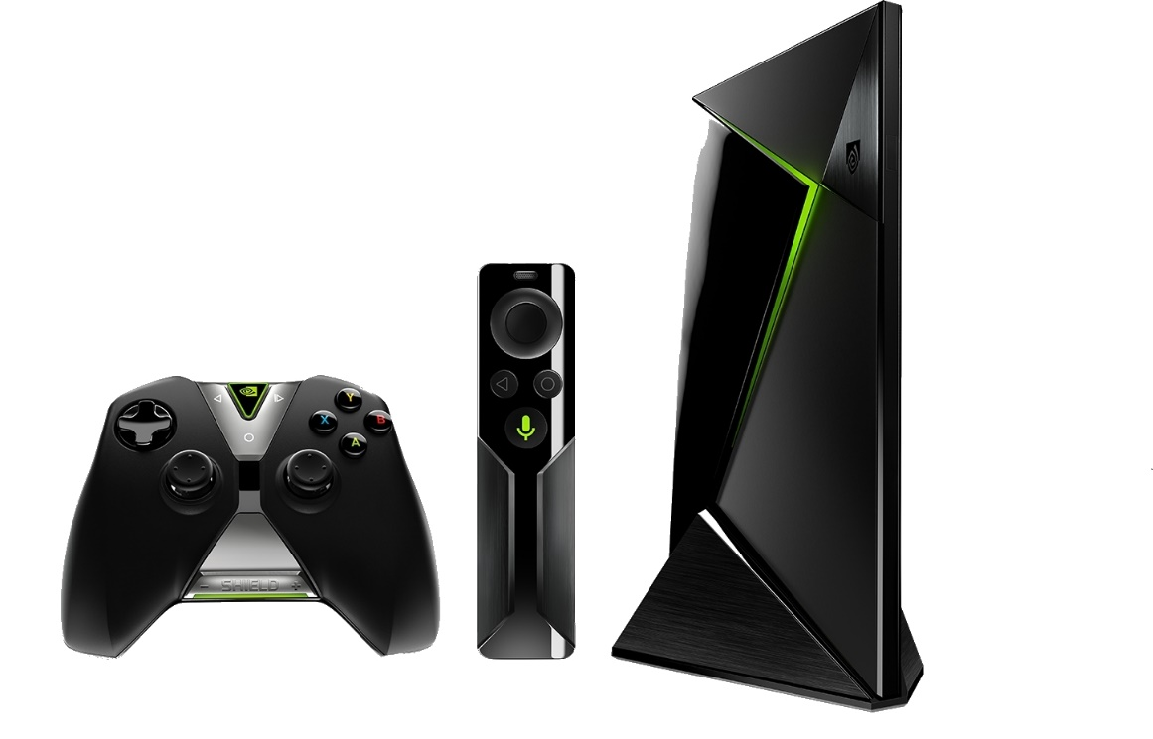
Nvidia Shield TV 2015
Android TV Box
Dual Band WLAN
Tegra X1 Processor
3 GB RAM
16GB & 500GB Version
Game Stream from your Computer
GeForce Now

Slide 4
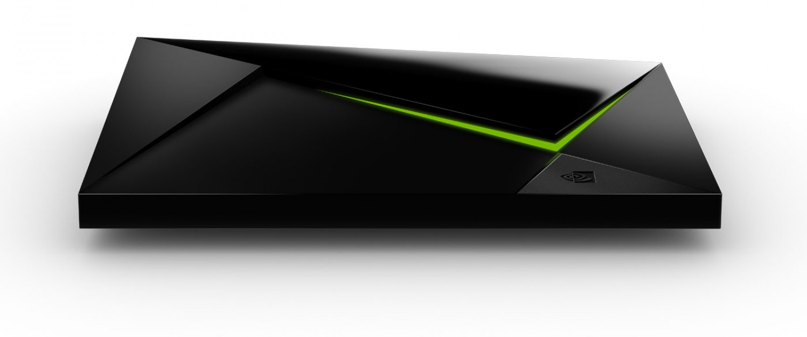
The Look – Nvidia Shield TV 2015
LED strip
Piano lacquer
Sensor field (Start button)

Slide 5
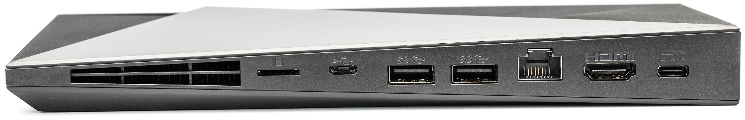
Ports - Nvidia Shield TV 2015
Ethernet port
Power port
Micro USB port
Micro SD card port
2x USB 3.0
HDMI 2.0 port

Slide 6
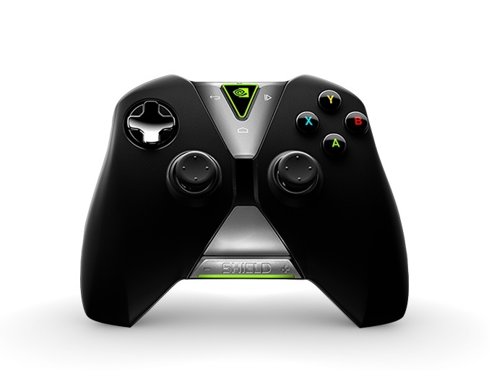
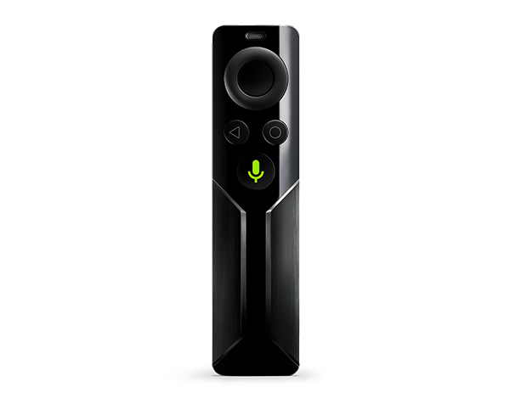
Accessoires – Nvidia Shield TV 2015
Android control elements
purchasable
Touch pad
attenuator
Touch pad attenuator

Slide 7
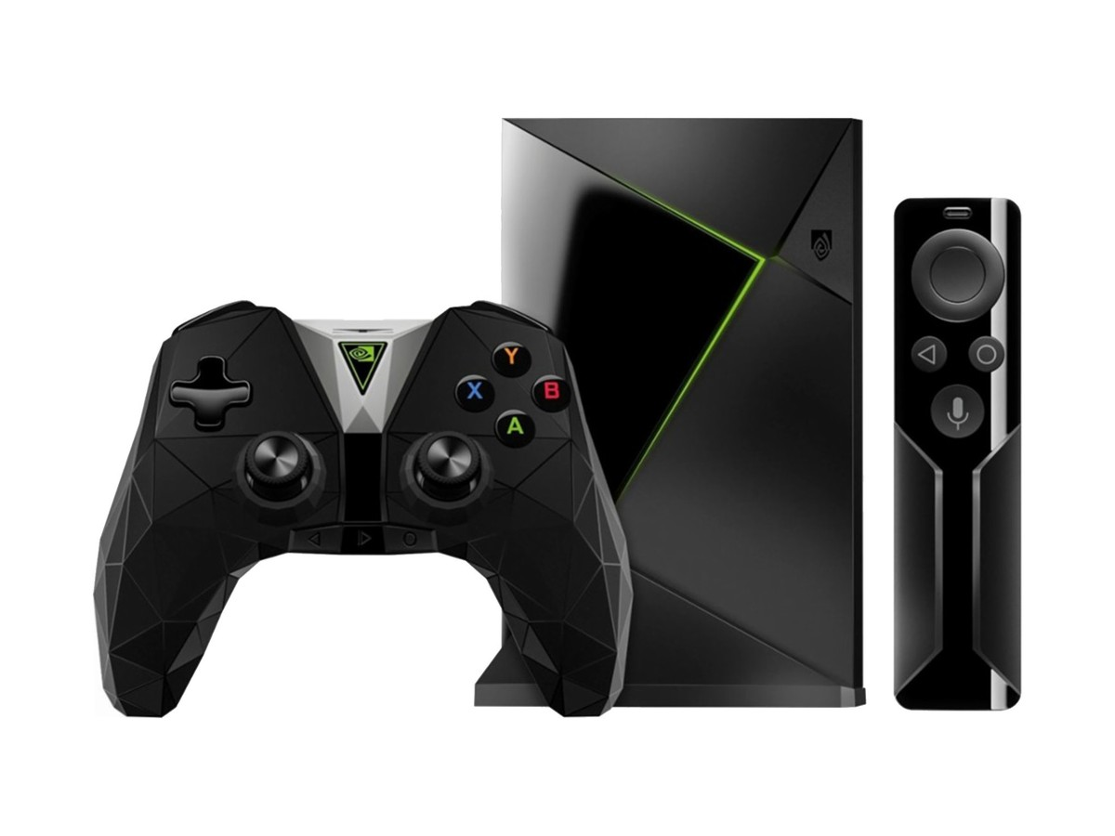
Nvidia Shield TV 2017
Smaller box
Remote control included
New controller design
Components are the same
16GB & 500GB Version
Game Stream from your Computer
GeForce Now

Slide 8
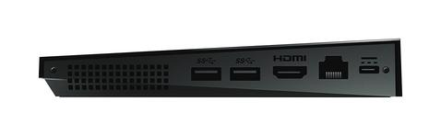
Ports - Nvidia Shield TV 2017
16GB Version:
No Micro SD &
Micro USB Slot
500GB Version:
All Ports are included

Slide 9


Comparison Nvidia Shield TV 2015 & 2017
VS
Advantages
Cheaper
All ports in both versions
Drawbacks
No Remote Control
Advanteges
Remote Control included
New
4k Content
Drawbacks
expensive

Slide 10
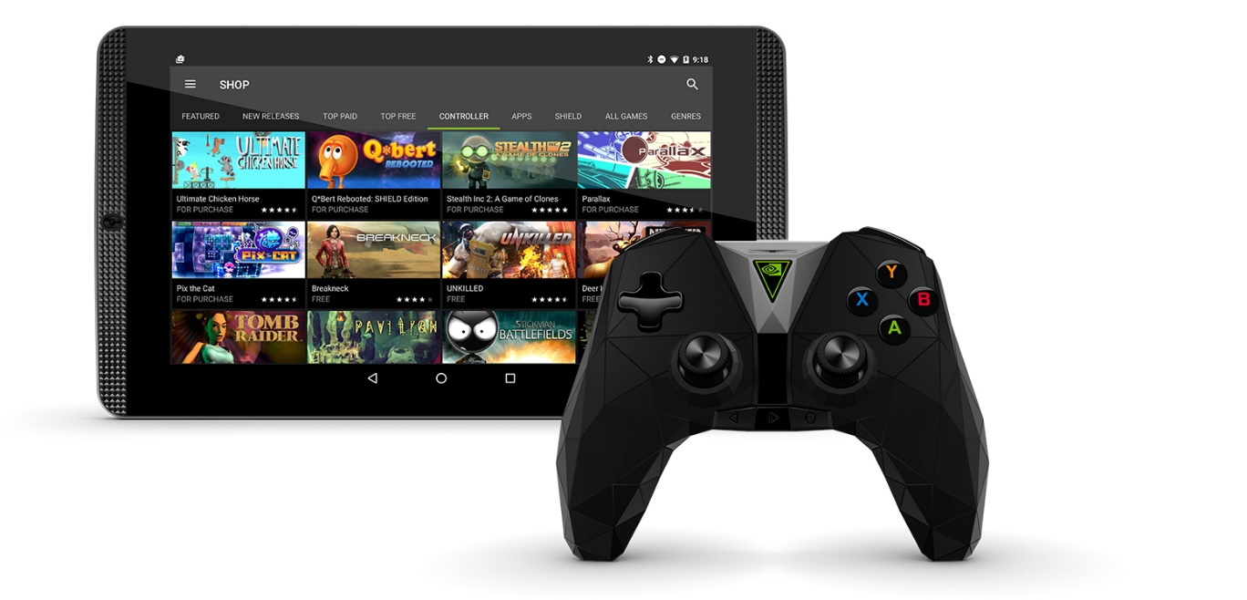
Nvidia Shield Tablet
Android Tablet
8 Inch Display
1920x1200
5Mp Front & Back Camera
16GB & 32GB Version
Tegra K1 Processor
5000MP Battery
2GB RAM
Includes Shield Controler
Includes Direct Stilo

Slide 11
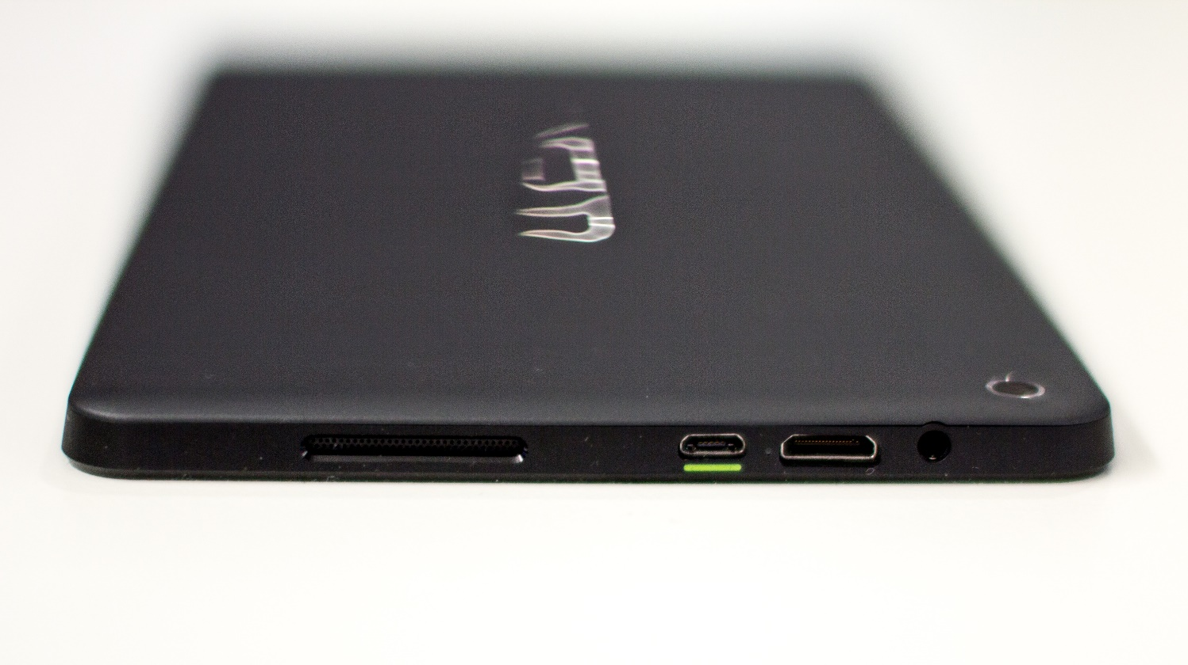
Ports - Shield Tablet
Audio Port
Micro USB Port
Mini HDMI Port

Slide 12
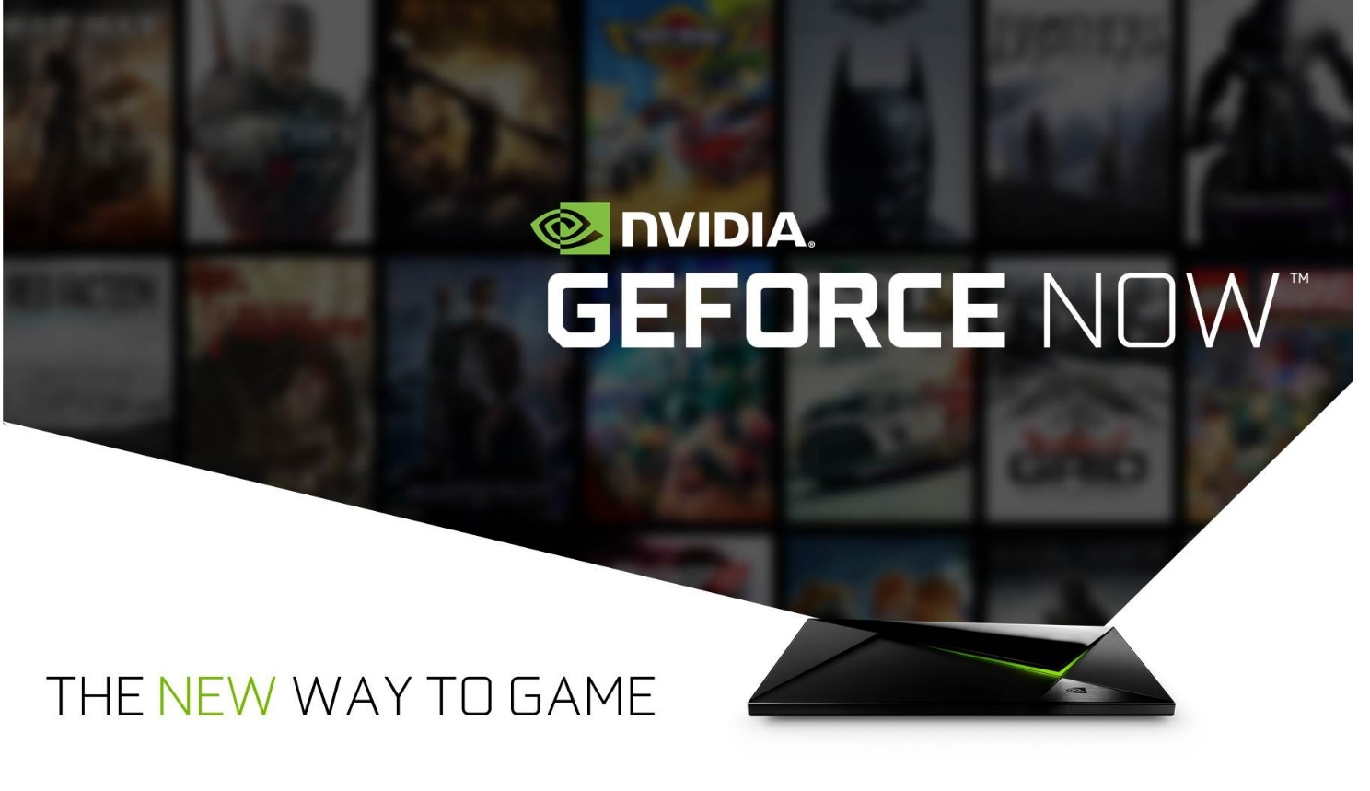
GeForce Now
Game Stream
Cheap «Gaming Computer»

Slide 13

Any Questions?

